Slide 1

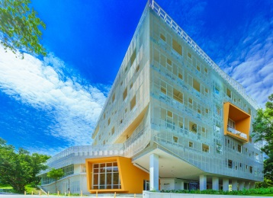

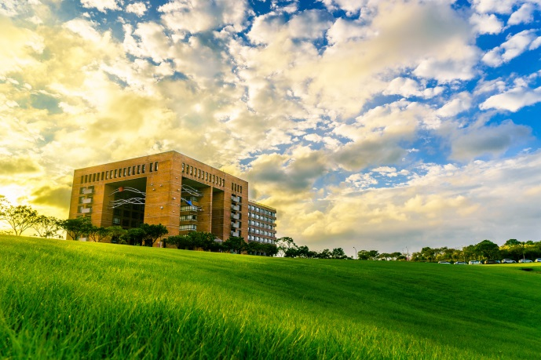
Computational Fluid Dynamics Analyses of Molten Salt Systems with Neutronics Feedback
王振安 Jennan Wang

Slide 2
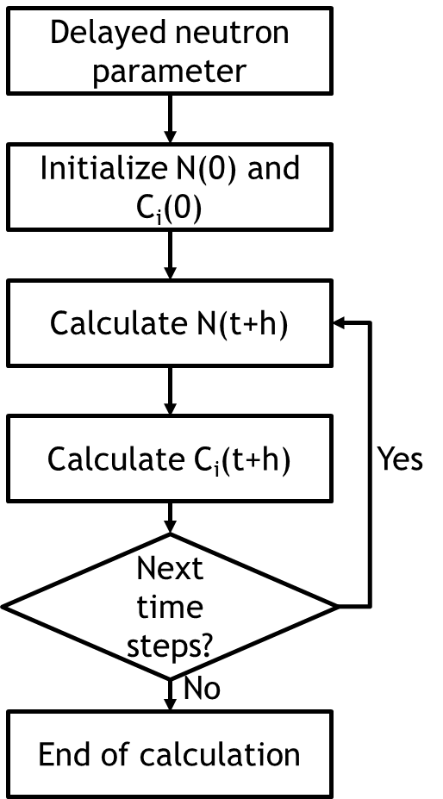
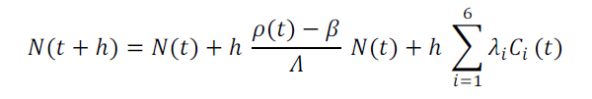


Development of Reactor Point Kinetics Equations Code
Reactor point kinetics equations:
$$\frac{dN(t)}{dt}=\frac{ρ\left(t\right)−β}{Λ}N\left(t\right)+\sum_{i=1}^{M}{λ_{i}C_{i}(t)}$$
$\frac{dC_{i}(t)}{dt}=\frac{β_{i}}{Λ}N\left(t\right)−λ_{i}C_{i}(t)$ (i=1,2,…,M)
It can be solved in various ways, and we can solve it simply by first order Taylor Series.
Where h is time step
D. McMahon and A. Pierson, “A Taylor Series Solution of the Reactor Point Kinetics Equations,” Computational Physics, 2010.

Slide 3
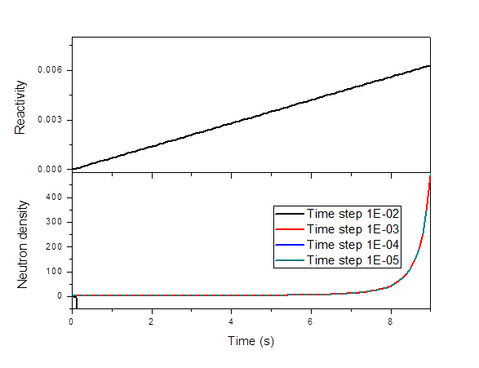
Reactor Point Kinetics Equations Code Validation
Step reactivity ρ=0.003
Step reactivity ρ=0.007
Ramp reactivity ρ=0.0007t
Time (s) | Quintero-Leyva | Kinard and Allen | McMahon and Pierson | Chao and Attard | This study Δt=1x10⁻⁴ s
t=1 | 2.2098 | 2.2098 | 2.2099 | 2.2098 | 2.2099
t=10 | 8.0192 | 8.0192 | 8.0192 | 8.0192 | 8.0192
t=20 | 28.297 | 28.297 | 28.297 | 28.297 | 28.297
Time (s) | Quintero-Leyva | Kinard and Allen | McMahon and Pierson | Chao and Attard | This study Δt=1x10⁻⁴ s | This study Δt=1x10⁻⁷ s
t=0.01 | 4.5088 | 4.5088 | 4.5086 | 4.5088 | 4.5439 | 4.5089
t=0.5 | 5345.8 | 5345.9 | 5344.7 | 5345.9 | 5534.0 | 5345.9
t=2 | 2.060x10¹¹ | 2.059x10¹¹ | 2.057x10¹¹ | 2.059x10¹¹ | 2.034x10¹¹ | 2.059x10¹¹
Time (s) | Quintero-Leyva | McMahon and Pierson | This study Δt=1x10⁻⁴ s
t=2 | 1.3382 | 1.3382 | 1.3382
t=4 | 2.2285 | 2.2285 | 2.2284
t=6 | 5.5822 | 5.5823 | 5.5823
t=8 | 42.790 | 42.789 | 42.789
t=9 | 487.61 | 487.52 | 487.52

Slide 4
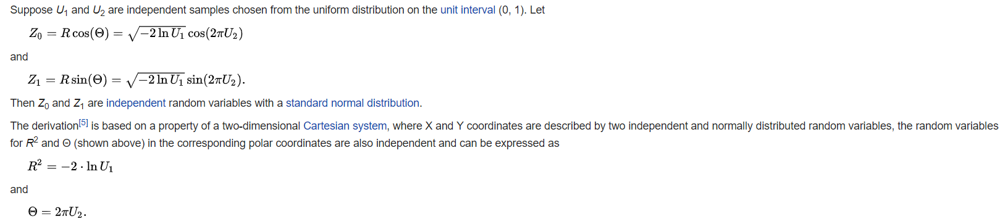
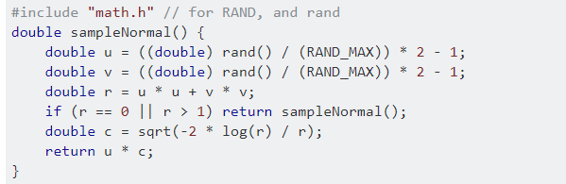
Normal distribution generation
Box–Muller transform is used
https://en.wikipedia.org/wiki/Box%E2%80%93Muller_transform

Slide 5
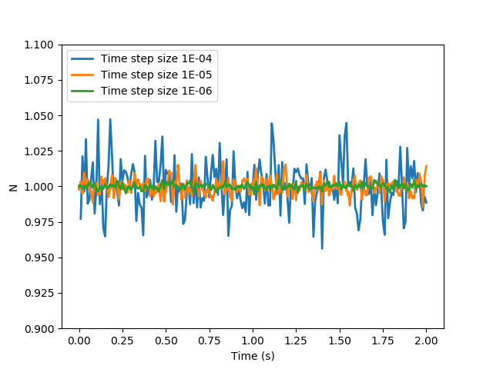
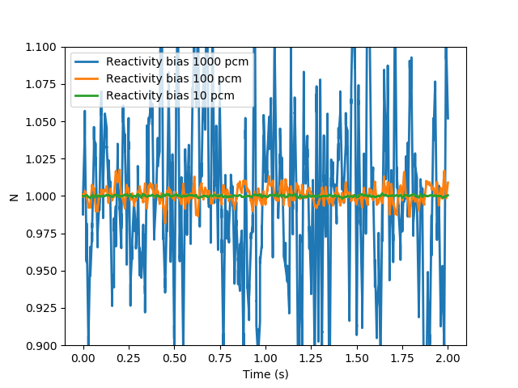
Reactivity=0
Print per 0.01sec
bais: 100 pcm
Time step size: 1E-05

Slide 6
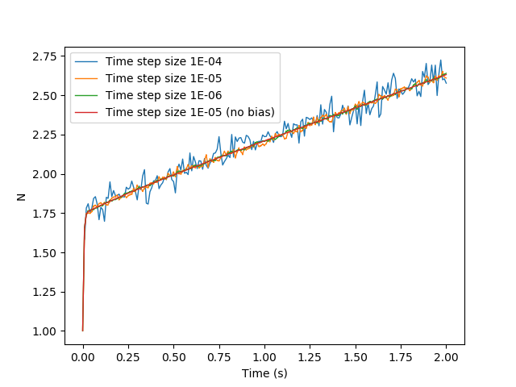
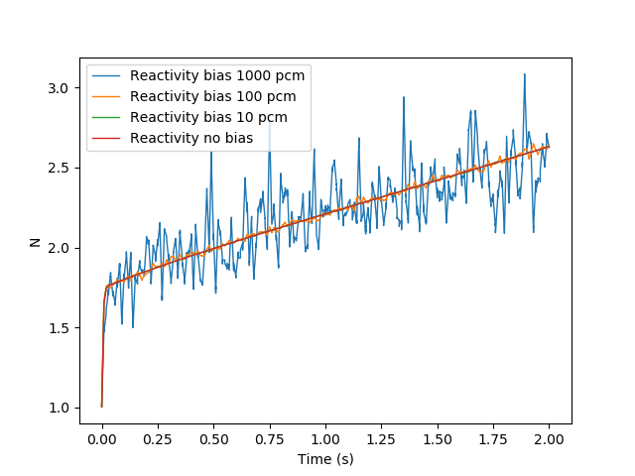
Step reactivity=0.003
Print per 0.01sec
bais: 100 pcm
Time step size: 1E-05

Slide 7
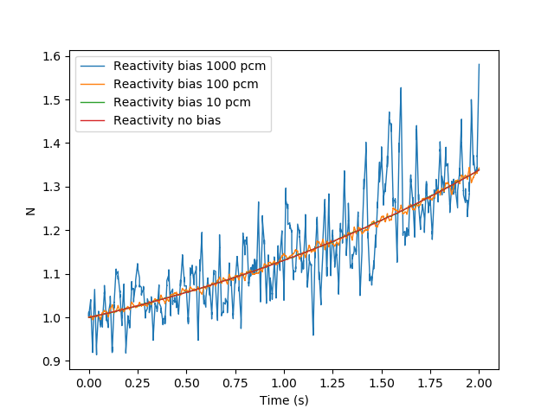
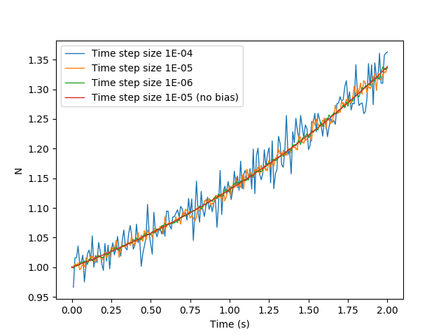
Ramp reactivity=0.0007t
Print per 0.01sec
bais: 100 pcm
Time step size: 1E-05

Slide 8
Thanks for Your Attention! Q&A
Photo by A.L. Li
Notes:
This
nightfall

Slide 9



https://en.wikipedia.org/wiki/Box%E2%80%93Muller_transform
$$\int_{0}^{∞}{f}dx=\int_{0}^{∞}{\frac{1}{\sqrt{2πσ^{2}}}e^{\frac{{−(x−μ)}^{2}}{2σ^{2}}}}=\frac{1}{\sqrt{2πσ^{2}}}\int_{0}^{∞}{e^{\frac{{−(x−μ)}^{2}}{2σ^{2}}}}=\frac{1}{\sqrt{2πσ^{2}}}\sqrt{2σ^{2}π}$$
https://math.stackexchange.com/questions/145087/how-to-calculate-the-integral-in-normal-distribution
https://docs.scipy.org/doc/scipy-0.16.1/reference/generated/scipy.stats.norm.html

Slide 11
Reference
Numerical solution of fractional stochastic neutron point kineetic equation for nuclear reactor dynamics
Study of stochastic reactor kinetic equation
Gotoh, Y.
Progress in Nuclear Energy, 1982, Vol.9, pp.303-31

